Slide 1
Design and Analysis of Algorithms
Insertion Sort
National University of Computer and Emerging Sciences, Islamabad

Slide 2
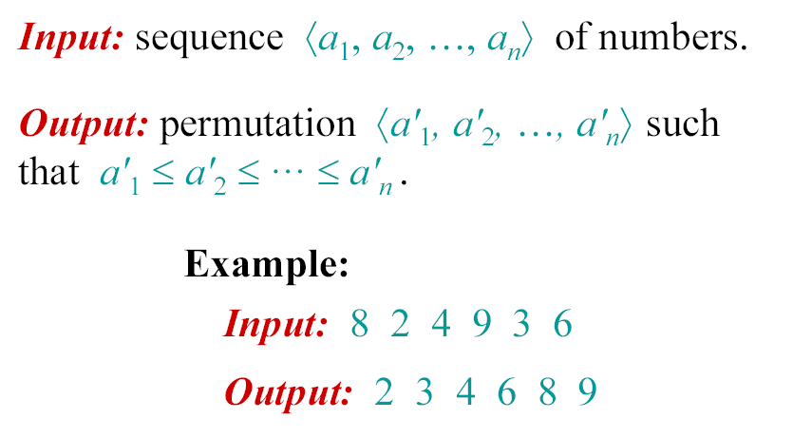
The problem of sorting

Slide 3
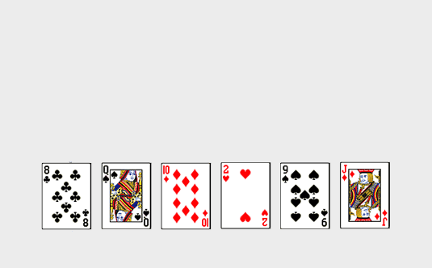
Insertion Sort of Cards

Slide 4
Insertion Sort
The list is divided into two parts: sorted and unsorted
In each pass, the following steps are performed
  First element of the unsorted part (i.e., sub-list) is picked up
  Transferred to the sorted sub-list
  Inserted at the appropriate place
A list of n elements will take at most n-1 passes to sort the data

Slide 5
Animation
https://visualgo.net/bn/sorting

Slide 6
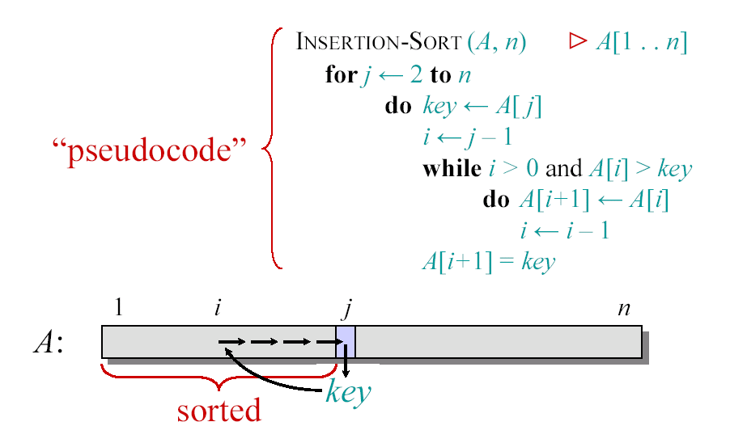
Insertion Sort

Slide 7

Example of Insertion Sort

Slide 8
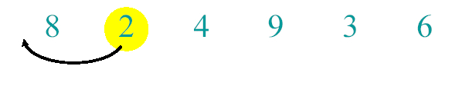
Example of Insertion Sort

Slide 9
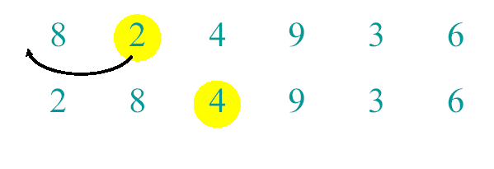
Example of Insertion Sort

Slide 10
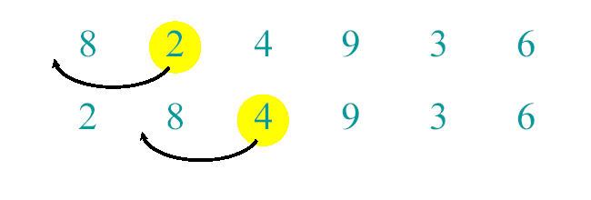
Example of Insertion Sort

Slide 11
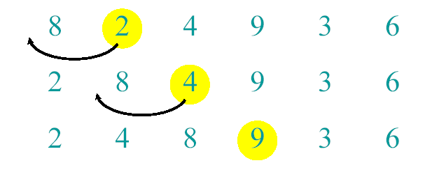
Example of Insertion Sort

Slide 12
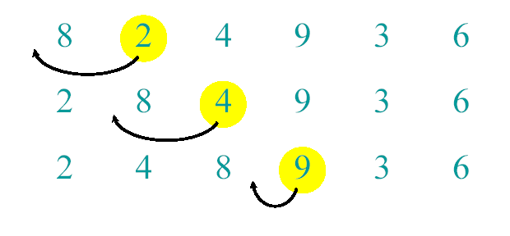
Example of Insertion Sort

Slide 13
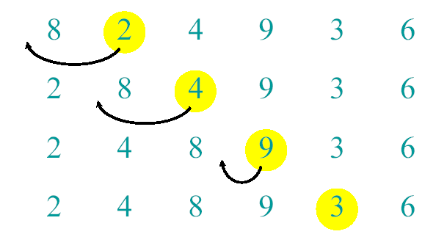
Example of Insertion Sort

Slide 14
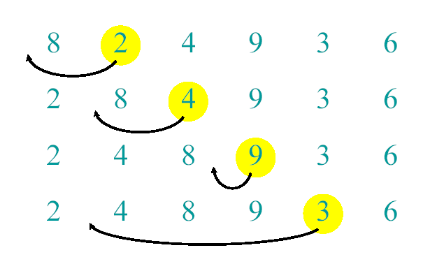
Example of Insertion Sort

Slide 15
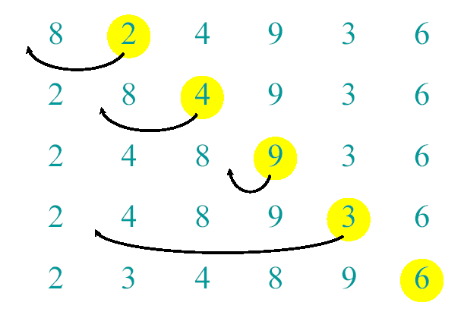
Example of Insertion Sort

Slide 16
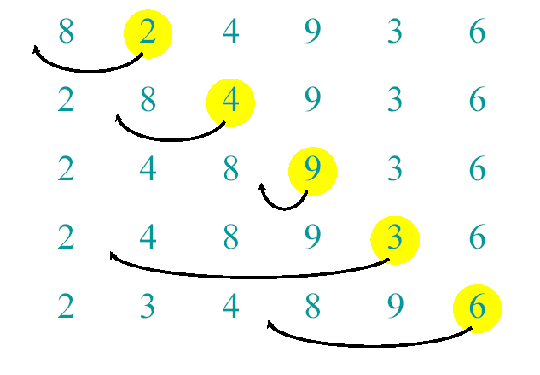
Example of Insertion Sort

Slide 17
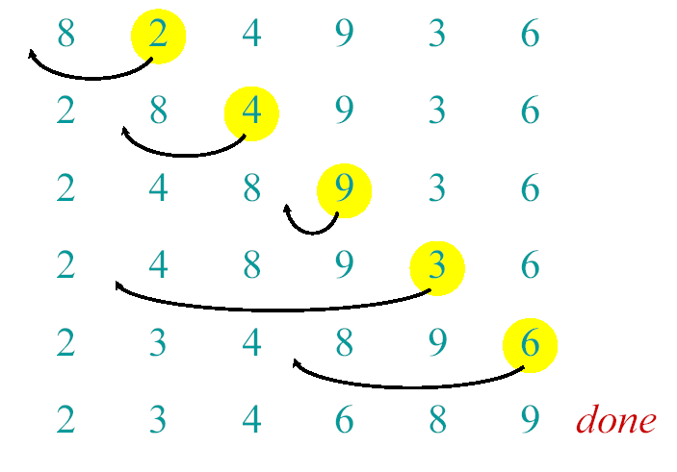
Example of Insertion Sort

Slide 18
Best Case
1 | 2 | 3 | 4 | 5

Slide 19
Worst Case
5 | 4 | 3 | 2 | 1

Slide 20
Running time of Insertion Sort
The running time depends on the input: an already sorted sequence is easier to sort.
Parameterize the running time by the size of the input,
  short sequences are easier to sort than long ones.
Generally, we seek upper bounds on the running time, because everybody likes a guarantee.

Slide 21
Kinds of Analyses
Worst-case: (Usually)
  T(n) = (maximum time of algorithm) on any input of size n.
Average-case (Sometimes):
  T(n) = (expected time of algorithm) over all inputs of size n.
  Need assumption of statistical distribution of inputs
Best-case: (bogus)
  Cheat with a slow algorithm that works fast on some input

Slide 22
Machine-independent time: An example
A pseudocode for insertion sort ( INSERTION SORT ).
INSERTION-SORT(A)
1 for j ← 2 to length [A]
2 do key ← A[ j]
3 ∇ Insert A[j] into the sorted sequence A[1,..., j-1].
4 i ← j – 1
5 while i > 0 and A[i] > key
6 do A[i+1] ← A[i]
7 i ← i – 1
8 A[i +1] ← key

Slide 23


Analysis of Insertion Sort
Time to compute the running time as a function of the input size
1.for j=2 to length(A)
2. do key=A[j]
3.“insert A[j] into the
sorted sequence A[1..j-1]”
4. i=j-1
5. while i>0 and A[i]>key
6. do A[i+1]=A[i]
7. i--
8. A[i+1]=key
cost
c₁
c₂
0
c₄
c₅
c₆
c₇
c₈
times
n
n-1
n-1
n-1
n-1

Slide 24
Insertion-Sort Running Time
T(n) = c₁ • (n) + c₂ • (n-1) + c₃ • (n-1) +
c₄ • (n-1) + c₅ • (Σ_{j=2,n} t_{j}) +
c₆ • ( Σ_{j=2,n} (t_{j} -1) ) + c₇ • ( Σ_{j=2,n} (t_{j} -1) )
+ c₈ • (n-1)
c₃ = 0, of course, since it’s the comment

Slide 25
Best/Worst/Average Case
Best case:
elements already sorted, t_{j}=1,
running time = f(n), i.e., linear time.
Worst case:
elements are sorted in inverse order,
t_{j}=j, running time = f(n²), i.e., quadratic time
Average case:
t_{j}=j/2, running time = f(n²),
i.e., quadratic time

Slide 26
Best Case Result
Occurs when array is already sorted.
For each j = 2, 3,…..n we find that A[i]<=key in line 5 when i has its initial value of j-1.
T(n) = c₁ • n + (c₂ + c₄) • (n-1) + c₅ • (n-1)+ c₈ • (n-1)
= n • ( c₁ + c₂ + c₄ + c₅ + c₈ )
+ ( -c₂ – c₄ - c₅ – c₈ )
= c₉n + c₁₀
= f₁(n¹) + f₂(n⁰)

Slide 27
Worst Case T(n)
Occurs when the loop of lines 5-7 is executed as many times as possible, which is when A[] is in reverse sorted order.
key is A[j] from line 2
i starts at j-1 from line 4
i goes down to 0 due to line 7
So, t_{j} in lines 5-7 is [(j-1) – 0] + 1 = j
The ‘1’ at the end is due to the test that fails, causing exit from the loop.

Slide 28
Worst Case T(n), ctd.
T(n) = c₁ • [n]+ c₂ • (n-1) + c₄ • (n-1)
+ c₅ • (Σ_{j=2,n} j)+ c₆ • [ Σ_{j=2,n} (j -
1) ] + c₇ • [ Σ_{j=2,n} (j -1) ]+ c₈ •
(n-1)

Slide 29
Worst Case T(n), ctd.
T(n) =
c₁ • n + c₂ • (n-1) + c₄ • (n-1) + c₈ • (n-1)
+ c₅ • (Σ_{j=2,n} j)
+ c₆ • [ Σ_{j=2,n} (j -1) ]+ c₇ • [ Σ_{j=2,n} (j -1) ]
= c₉ • n + c₁₀ + c₅ • (Σ_{j=2,n} j) + c₁₁ •
[Σ_{j=2,n} (j -1) ]

Slide 30
Worst Case T(n), ctd.
T(n) = c₉ • n + c₁₀ + c₅ • (Σ_{j=2,n} j) + c₁₁ • [ Σ_{j=2,n} (j -1) ]
But
Σ_{j=2,n} j = [n(n+1)/2] – 1
so that
Σ_{j=2,n} (j-1) = Σ_{j=2,n} j – Σ_{j=2,n} (1)
= [n(n+1)/2] – 1 – (n-2+1)
= [n(n+1)/2] – 1 – n + 1 = n(n+1)/2 - n
= [n(n+1)-2n]/2 = [n(n+1-2)]/2 = n(n-1)/2
Wasn’t that fun?

Slide 31
Worst Case T(n), ctd.
In conclusion,
T(n) = c₉ • n + c₁₀ + c₅ • [n(n+1)/2] – 1 + c₁₁ • n(n-1)/2
= c₁₂ • n² + c₁₃ • n + c₁₄
= f₁(n²) + f₂(n¹) + f₃(n⁰)

Slide 32
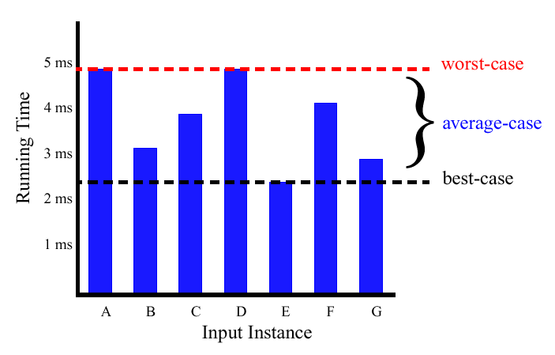
Best/Worst/Average Case (2)
  For a specific size of input n, investigate running times for different input instances:
6n
5n
4n
3n
2n
1n

Slide 33
Insertion Sort Analysis
Is insertion sort a fast sorting algorithm?
  Moderately so, for small n
  Not at all, for large n
  sorting "almost sorted" lists

Slide 34
Reference
Introduction to Algorithms
Chapter # 2
  Thomas H. Cormen
  3rd Edition
https://visualgo.net/bn/sorting

